Slide 1
Branch and Bound

Slide 2
Branch and Bound
The branch-and-bound design strategy is very similar to backtracking in that a state space tree is used to solve a problem.
The differences are that the branch-and-bound method
does not limit us to any particular way of traversing the tree.
Is used only for optimization problems.
A branch-and- bound algorithm computes a number (bound) at a node to determine whether the node is promising. The number is a bound on the value of the solution that could be made and if worse than the value of the best solution found so far, the node is nonpromising.
Otherwise, it is promising.

Slide 3
Branch and Bound
Because the optimal value is a minimum in some problems and a maximum in others, by "better" we mean smaller or larger depending on the problem.
As in the case for backtracking algorithms, branch-and-bound algorithms are ordinarily exponential-time (or worse) in the worst case.

Slide 4
Branch and Bound
However, they can be very efficient for many large instances.

Slide 5
Branch and Bound
A backtracking algorithm, however, does not exploit the real advantage of using branch-and-bound. Besides using the bound to determine whether a node is promising, we can compare the bounds of promising nodes and visit the children of the one with the best bound.
In this way we often can arrive at an optimal solution faster than we would by methodically visiting the nodes in some predetermined order (such as a depth-first search).
This approach is called best-first search with branch-and-bound pruning.

Slide 6
Branch and Bound
The implementation of the approach is a simple modification of another methodical approach called breadth-first search with branch-and-bound pruning.

Slide 7
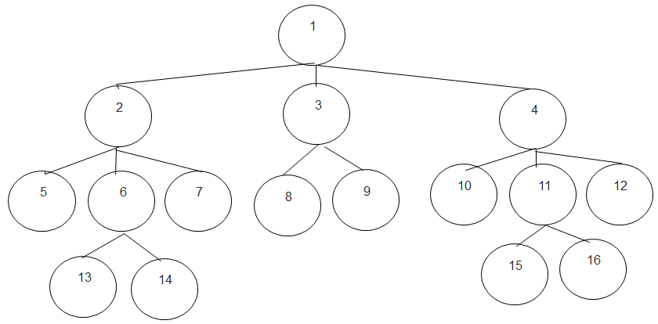
Breadth First Search
In the case of a tree, a breadth-first search consists of visiting the root first, followed by all nodes at level 1, followed by all nodes at level 2, and so on.

Slide 8
Implementation of Breadth First
Unlike depth-first search, there is no simple recursive algorithm for breadth-first search.
However, we can implement it using a queue. The algorithm that follows does this.
Recall we insert an item at the end of the queue with a procedure called enqueue, and we remove an item from the front with a procedure called dequeue.

Slide 9
Breadth First Search Code
void breadthFirst_tree_search (tree T)
{
queue_of_node Q;
node u, v,
initialize(Q); //Initialize Q to be empty.
v = root of T;
visit v;
enqueue(Q, v);
while (! empty(Q)) {
dequeue(Q, v);
for ( each child u of v) {
visit u;
enqueue(Q, u);
}
}
}

Slide 10
Breadth-first Search , Branch & Bound Pruning Discussion
This is like breadth-first search but we also use the bound to prune.
The value of best has be initialized worst than any possible value
This strategy is no better than depth first search, however we can improve it.
If instead of choosing just the breadth first next node, we choose the one that looks “best”!
We expand each level just as in Breadth first but the next node to check is the one that looks “best”

Slide 11
Best first Search /Branch & Bound
First we discuss a simple version called breadth-first search with branch-and-bound pruning .
Consider the 0/1 Knapsack Problem, where
Given a knapsack that holds a max weight W
n items each with a values (profits) p_{i} , weight w_{i}
Determine which items to fit into the pack to maximize the profit without going over the max weight limit.

Slide 12
Breadth-first Search , Branch & Bound Pruning
Using breadth-first search with branch-and-bound pruning, we proceed as we did using backtracking, except that we do a breadth-first search instead of a depth- first search.
Let weight and profit be the total weight and total profit of the items that have been included up to a node.
To determine whether the node is promising, we initialize totweight and bound to weight and profit, respectively, and then greedily grab items, adding their weights and profits to totweight and bound, until we reach an item whose weight would bring totweight above W. We grab the fraction of that item allowed by the available weight, and add the profit of that fraction to bound

Slide 13
Breadth-first Search , Branch & Bound Pruning
In this way, bound becomes an upper bound on the amount of profit we could obtain by expanding beyond the node. If the node is at level i, and the node at level k is the one whose weight would bring the weight above W,
totweight = weight + S_{j=i+1}^{k-1} w_{j}
bound = profit +S_{j=i+1}^{k-1}p_{j} +(W-totweight) × p_{k}/ w_{k}

Slide 14
Breadth-first Search
The breadth-first search strategy has no advantage over a depth-first search (backtracking).
However, we can improve our search by using our bound to do more than just determine whether a node is promising.

Slide 15
0-1 Knapsack
0-1 Knapsack using the branch and bound.
Now look at all promising, unexpanded nodes and expand beyond the one with the best bound.
We often arrive at an optimal solution more quickly than if we simply proceeded blindly in a predetermined order.

Slide 16
Best-first Search
Best-first search expands the node with the best bounds next.
How would you implement a best-first search?
Depth-first is a stack
Breadth-first is a queue
Best-first is a ???

Slide 17
0-1 Knapsack
Capacity W is 10
Upper bound is $100 (use fractional value)
Item | Weight | Value | Value / weight
1 | 4 | $40 | 10
2 | 7 | $42 | 6
3 | 5 | $25 | 5
4 | 3 | $12 | 4

Slide 18
Computing Upper Bound
To compute the upper bound, use
ub = v + (W – w)(v_{i+1}/w_{i+1})
So the maximum upper bound is
pick no items, take maximum profit item
ub = (10 – 0)*($10) = $100
After we pick item 1, we calculate the upper bound as
all of item 1 (4, $40) + partial of item 2 (7, $42)
$40 + (10-4)*6 = $76
If we don’t pick item 1:
ub = (10 – 0) * ($6) = $60

Slide 19
State Space Tree
with 1
0
without 1
1
2
with 2
without 2
inferior to node 8
3
4
not feasible
with 3
without 3
5
6
inferior to node 8
with 4
without 4
7
8
not feasible
optimal solution

Slide 20
Summary of State Space Tree
To compute the upper bound, use
ub = v + (W – w)(vi+1/wi+1)
So the maximum upper bound is as follows
pick no items, take maximum profit item
ub = (10 – 0)*($10) = $100
After we pick item 1, we calculate the upper bound as
all of item 1 (4, $40) + partial of item 2 (7, $42)
$40 + (10-4)*6 = $76
If we don’t pick item 1:
ub = (10 – 0) * ($6) = $60
pick 1 = $76 > don't pick 1 = $60 so look at item 2
After we pick item 2
because w = 11 - not feasible
no ub
If we pick item 1 but don’t pick item 2:
all of item 1 (4, $40) + partial of item 3 (5, $25)
ub = $40 + (10 – 4) * ($5) = $70
pick 1, don't pick 2 = $70 > don't pick 1 = $60 so look at item 3

Slide 21
Summary of State Space Tree
pick 1, don't pick 2 = $70 > don't pick 1 = $60 so look at item 3
If we pick item 1 but don’t pick item 2 and pick item 3:
all of item 1 (4, $40) + all of item 3 + partial of item 4 (3, $12)
ub = $65 + (10 – 9) * ($4) = $69
If we pick item 1 but don’t pick item 2 and don't pick item 3:
all of item 1 (4, $40) + partial of item 4 (3, $12)
ub = $40 + (10 – 4) * ($4) = $64
pick 1, don't pick 2, pick 3 = $69 > pick 1, don't pick 2, don't pick 3 = $64 > don't pick 1 = $60 so look at item 4
After we pick item 4
because w = 12 - not feasible
no ub
If we pick item 1 but don’t pick item 2 and pick item 3 but don't pick item 4:
all of item 1 (4, $40) + all of item 3 (5,$25) + $0 (no more elements)
ub = $65 + (10 – 9) * ($0) = $65 ($0 since no more items)
pick 1, don't pick 2, pick 3, don't pick item 4 = $65 > pick 1, don't pick 2, don't pick 3 = $64
> don't pick 1 = $60
STOP .... cannot reach better solution
Solution is pick item 1 but don’t pick item 2 and pick item 3 but don't pick item 4

Slide 22
Bounding
A bound on a node is a guarantee that any solution obtained from expanding the node will be:
Greater than some number (lower bound)
Or less than some number (upper bound)
If we are looking for a maximal optimal (knapsack), then we need an upper bound
For example, if the best solution we have found so far has a profit of 12 and the upper bound on a node is 10 then there is no point in expanding the node
The node cannot lead to anything better than a 10

Slide 23
Bounding
Recall that we could either perform a depth-first or a breadth-first search
Without bounding, it didn’t matter which one we used because we had to expand the entire tree to find the optimal solution
Does it matter with bounding?
Hint: think about when you can prune via bounding

Slide 24
Bounding
We prune (via bounding) when:
(currentBestSolutionCost >= nodeBound)
This tells us that we get more pruning if:
The currentBestSolution is high
And the nodeBound is low
So we want to find a high solution quickly and we want the highest possible upper bound
One has to factor in the extra computation cost of computing higher upper bounds vs. the expected pruning savings

Slide 25
Enumeration in a search tree
root node
Level 0
each node is a partial solution, i.e. a part of the solution space
child nodes
Level 1
...
child nodes
Level 2
...

Slide 26
The assignment problem
We want to assign n people to n jobs so that the total cost of the assignment is as small as possible (lower bound)

Slide 27
Example: The assignment problem
Select one element in each row of the cost matrix C so that:
no two selected elements are in the same column; and
the sum is minimized
For example:
Job 1 Job 2 Job 3 Job 4
Person a 9 2 7 8
Person b 6 4 3 7
Person c 5 8 1 8
Person d 7 6 9 4
Lower bound: Any solution to this problem will have
total cost of at least:
sum of the smallest element in each row = 10

Slide 28
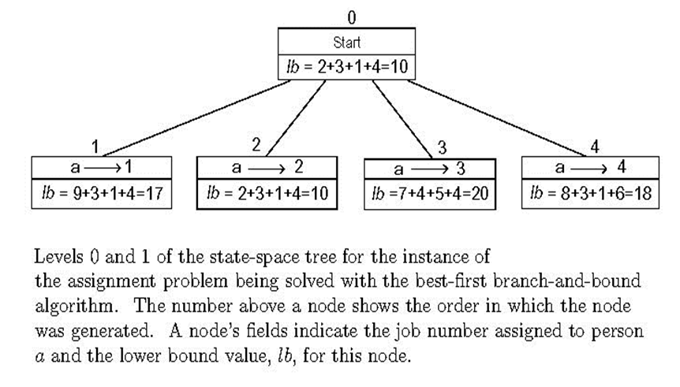
Assignment problem: lower bounds

Slide 29
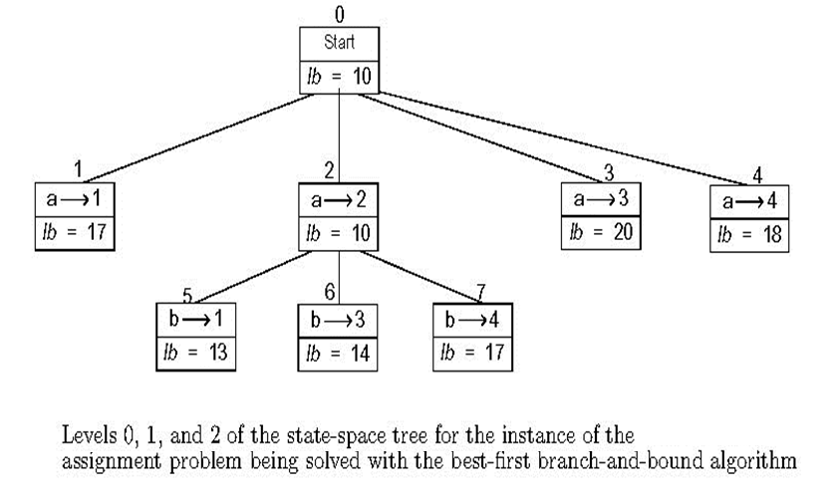
State-space levels 0, 1, 2

Slide 30
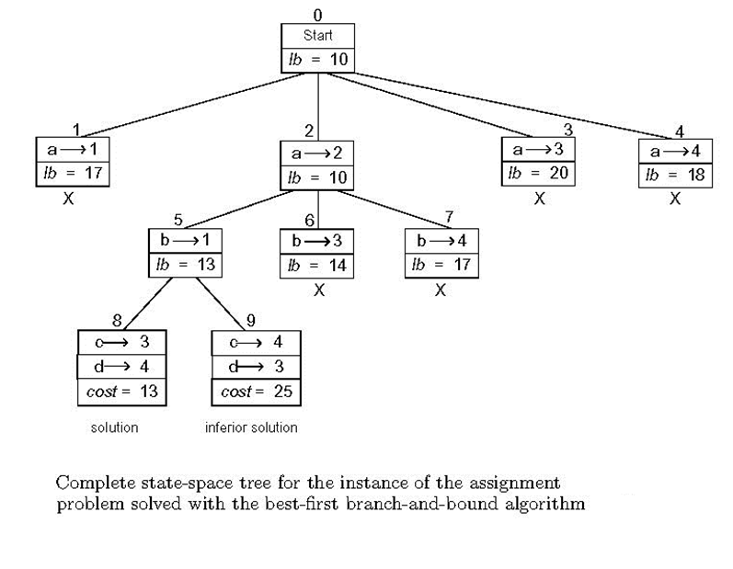
Complete state-space

Slide 31
Traveling Salesman Problem
Can apply branch & bound if we come up with a reasonable lower bound on tour lengths.
Simple lower bound = finding smallest element in the intercity distance matrix D and multiplying it by number of cities n
Alternate solution:
For each city i, find the sum s_{i} of the distances from city i to the two nearest cities;
compute the sum s of these n numbers;
divide the result by 2
and if all the distances are integers, round up the result to the nearest integer;

Slide 32
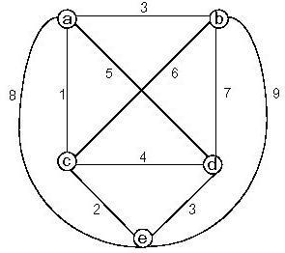
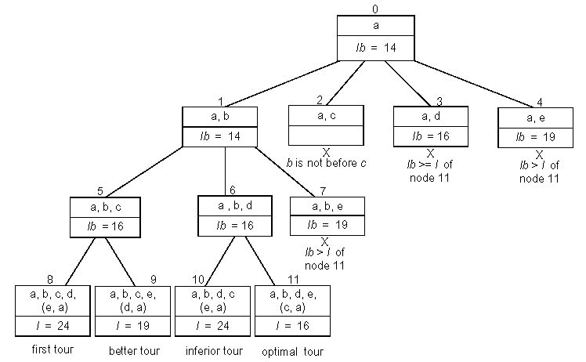
Traveling salesman example:
lb = [(1+3)+(3+6)+(1+2)+(3+4)+(2+3)]/2 = 14

Slide 33
Summary: Branch and bound
Feasible solution
Optimal solution
Breadth-First Search
Best-First Search (with branch-and-bound pruning)

Slide 34
Summary: Branch and bound
Branch and Bound is:
a general search method.
minimize a function f(x), where x is restricted to some feasible region.
To apply branch and bound, one must have:
a means of computing a lower bound on an instance of the optimization problem.
a means of dividing the feasible region of a problem to create smaller subproblems.
a way to compute an upper bound (feasible solution) for at least some instances.

Slide 35
Summary: Branch and bound
The method starts by:
considering the original problem with the complete feasible region (called the root problem).
The lower-bounding and upper-bounding procedures are applied to the root problem.
If the bounds match, then an optimal solution has been found. Otherwise, the feasible region is divided into two or more regions, which together cover the whole feasible region.
These subproblems become children of the root search node.
The algorithm is applied recursively to the subproblems, generating a tree of subproblems.

Slide 36
Summary: Branch and bound
If an optimal solution is found to a subproblem,
it is a feasible solution to the full problem, but not necessarily globally optimal.
Since it is feasible, it can be used to prune the rest of the tree:
if the lower bound for a node exceeds the best known feasible solution, no globally optimal solution can exist in the subspace of the feasible region represented by the node.
Therefore, the node can be removed from consideration.
The search proceeds until all nodes have been solved or pruned, or until some specified threshold is meet between the best solution found and the lower bounds on all unsolved subproblems.

